Slide 1

Introduction to Certified Quorum Developer
1

Slide 2


Certified Quorum DeveloperTM
This certification training is a comprehensive, in-depth journey into Quorum. Quorum projects are designed for traditional businesses that are trying to improve internal data integrity, collaboration, and bring about cost-effective solutions within their organizations. It is an advanced online certification training designed for individuals to gather architectural knowledge on Quorum.

Slide 3


Objectives
An understanding of Quorum.
An understanding of the Quorum open source project.
Exploring the Quorum ecosystem.
Designing and running Quorum DApps.
Running a transaction.

Slide 4
For Whom
Investment Bankers, Consultants, & Advisors.
University Professors.
Engineering & Management Students.
Programmers & Developers.
Software Engineers & Architects.
Application Architects.
Cryptocurrency Enthusiasts.
Operations Heads of Businesses.
Senior Government Officials.
Security Professionals, Administrators.

Slide 5

Benefits of taking this Course
Prove your Quorum functional skills & understanding.
Gain an in-depth understanding of Quorum and its Ecosystem.

Slide 6
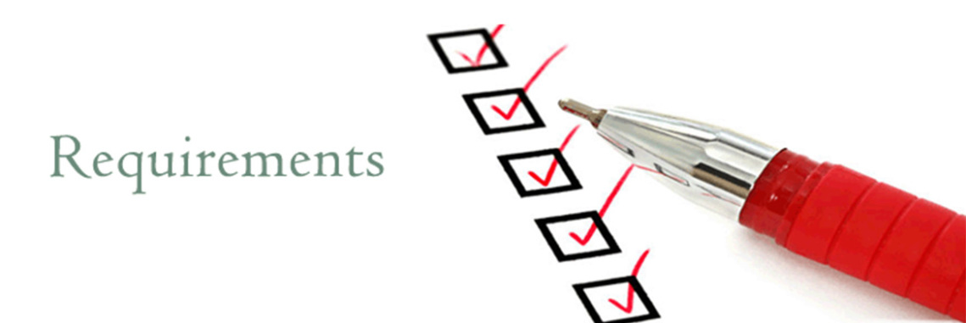
Requirements to take this Certification
Basic knowledge of Computer Science.
Awareness of Cryptocurrencies like Bitcoin, Ethereum etc.
Basic knowledge of any programing language.

Slide 7
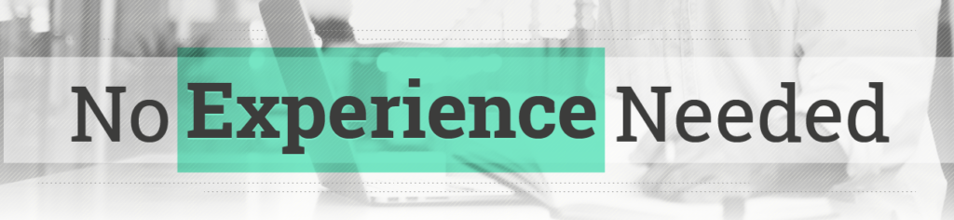
Recommended Experience
There is no such recommended experience required for getting this certification.

Slide 8

Duration for the Course
A total of 4-5 Hours of training.
1 hour for exam.
Training will be online (self-paced).
Training can be consumed as per the candidate’s availability & online speed.

Slide 9

Exam
There will be an online multiple choice exam of 100 marks followed by the training.
You need to acquire 60+ marks to clear the exam.
If you fail the exam, you can retake the exam after 1 day.
You can take the exam at the maximum of 3 times.
If you fail to acquire 60+ marks even after 3 attempts, you would need to contact the Blockchain Council team to have manual assistance for clearing the exam.

Slide 10

Course Content
Introduction to Blockchain
What is Blockchain?
Introduction to Ethereum
What is Ethereum?
What is Ethereum Virtual Machine?
What is Solidity?
What are Smart Contracts?
Introduction to Quorum
What is Quorum?
Features of Quorum
Advantages and Disadvantages of Quorum
Comparison of Quorum with other blockchain technologies

Slide 11
Course Content
Quorum Ecosystem
Data Structure
Quorum Architecture
Quorum Key Components
Quorum Network
What is Quorum Network?
Quorum Transaction Processing and Privacy
What is Quorum Transaction?
Quorum Private Transaction
Quorum Public Transaction
Quorum Contracts
Quorum Public Contract
Quorum Private Contract

Slide 12
Course Content
Quorum Consensus
Overview to Consensus
RAFT- Based Consensus
Istanbul BFT Consensus
Clique POA Consensus
ZSL: Zero-knowledge Security Layer
What is zk-SNARKS?
What is ZSL?
Components of ZSL
ZSL Example
Requirement for Quorum
Repositories
Tools
Libraries
Languages

Slide 13
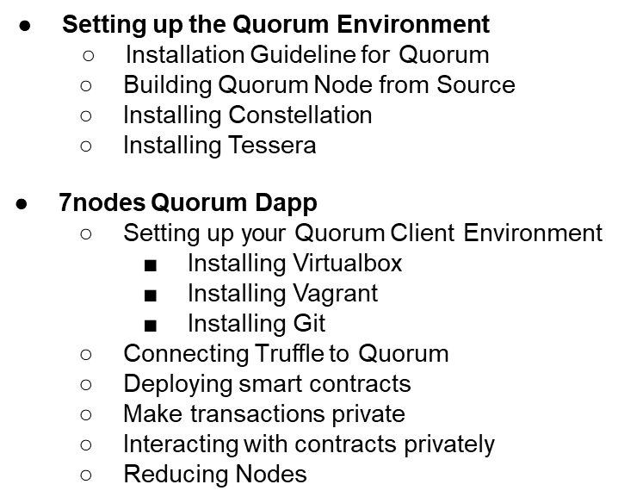
Course Content
13

Slide 14
THANK YOU!
14

